Slide 1

VTP
Anudeep Potlapally
Travis Rous

Slide 2
Client/Company
Nick Newell
EchoStar

Slide 3
Project
Web-based application
Video Sharing/Social Networking

Slide 4
Passed Sprints
Sprint 1:
Very Simple prototype
Sprint 2:
Research and contact Google
Database Design
Integration of Popcorn.js
Creating a Favorites page
Login via Google and Facebook
Error log

Slide 5
Passed Sprints
Sprint 3
Added image tags to database for video
Continued work on favorites page
Uses database to get information to populate based on the current user.
Sprint 4
Uploading videos into YouTube
Search for YouTube was added
Added more tags

Slide 6
Passed Sprints
Sprint 5
CSS changes
Friends Page
Profile Page
User Authentication
Added Vimeo
Unified Search and URL load bar

Slide 7
Remaining Backlog
Filtering the Tags
GUI Design

Slide 8
Testing
Beta Testers

Slide 9
Current Prototype

Slide 10
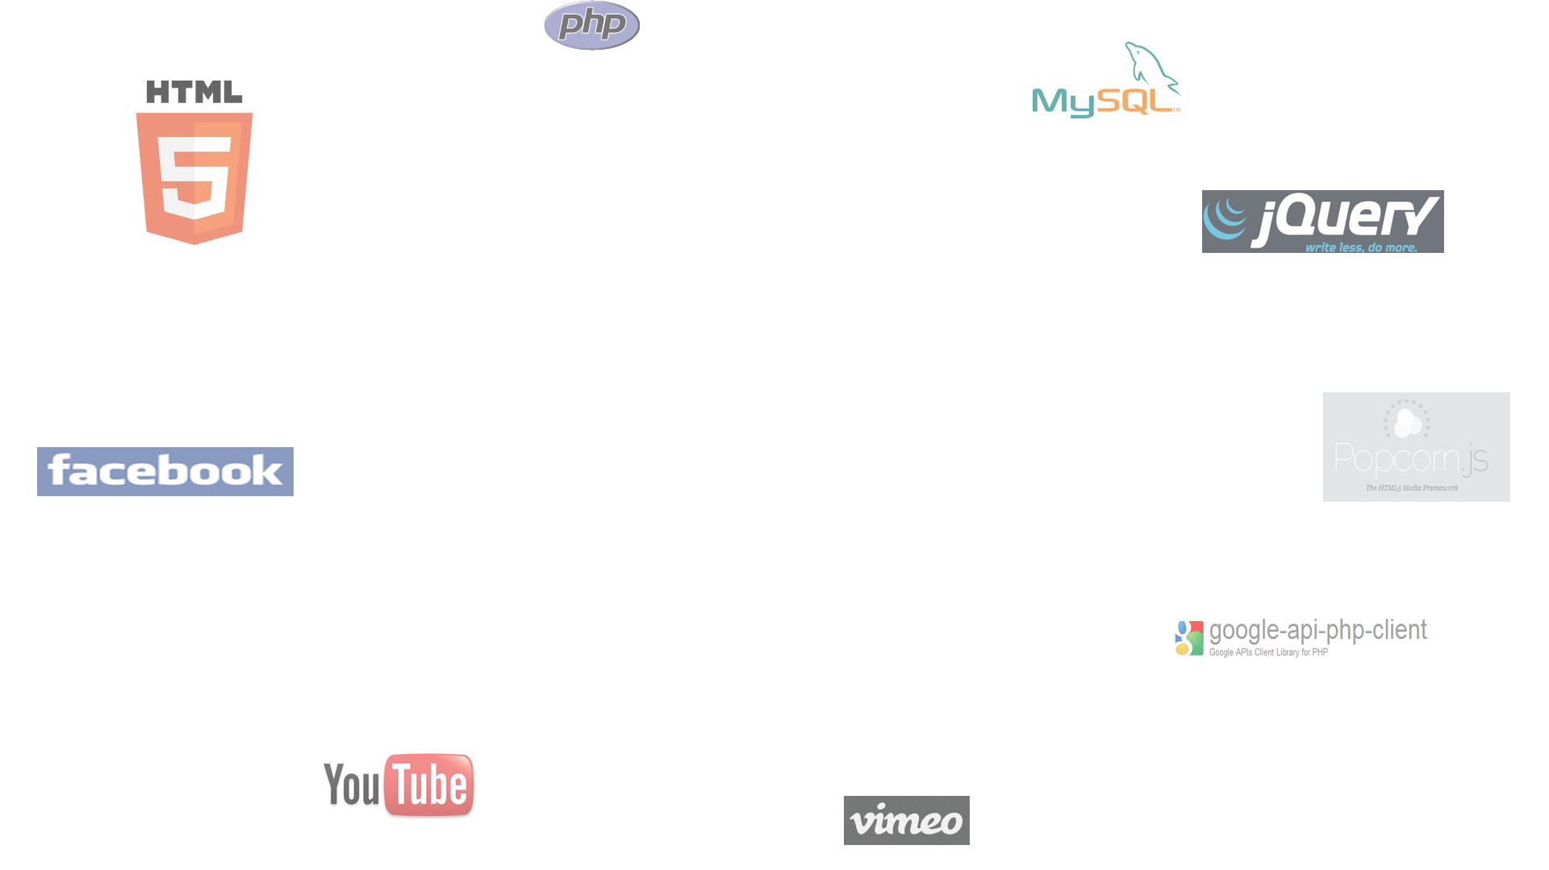
Questions?

